Slide 1
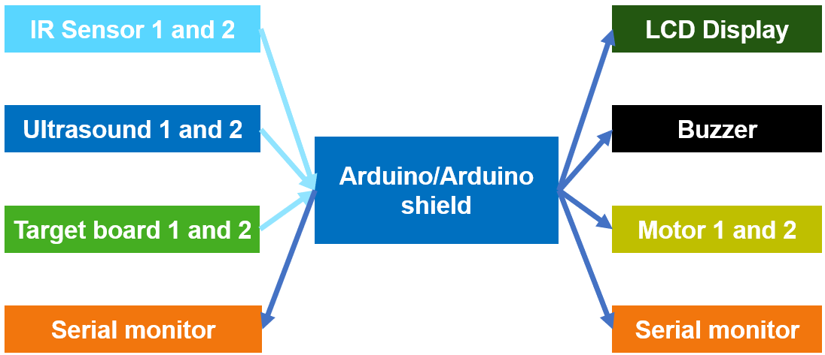
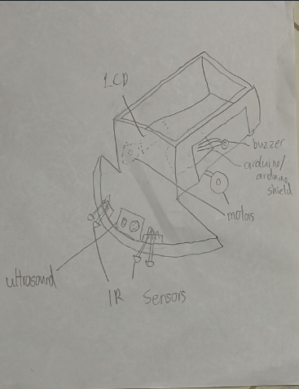
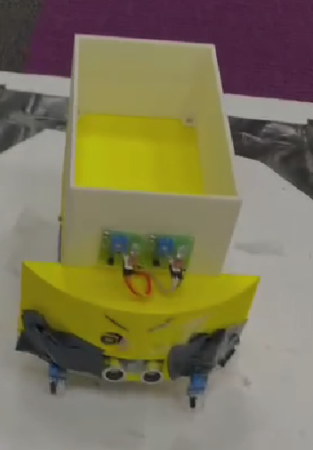
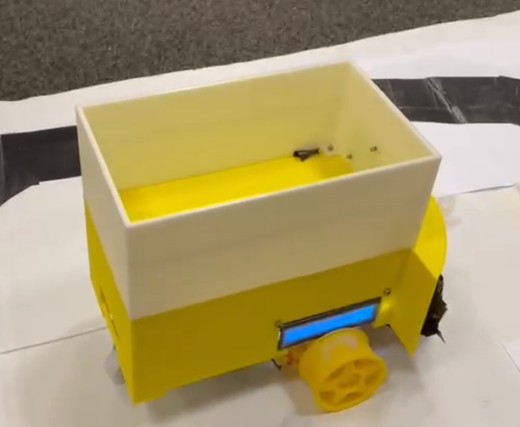
Self-driving parcel delivery robot
ET1015/ET1024 Introduction to Engineering & Design
Problem
Our Team
Hardware design
Implementation / Outcome / Improvements
The problem your team has identified to solve related UN SDG
Goal 8: Decent work and economic growth
My team is focusing on Target 8.2: Achieve higher levels of economic productivity through diversification, technological upgrading and innovation, including through a focus on high-value added and labor-intensive sectors.
We felt that the majority of warehouse worker are overworked and quit their jobs due to stress or even committing suicide in some cases. We felt that this problem needs to be urgently addressed.
(Toh Bao Yi) Tasks like making the track for the line follower, coding a function. Troubleshooting the code in order to make it run properly.
(Min hao) Assembly of the car, Coding the skeleton of the code and most of the functions
(Kimberly) Designing and printing the chassis, Video editing, Troubleshooting some code.
Implementation:
The chasis of the autonomous vehicle is 3D printed to be cost effective.
The black lines on the track were taped onto a large piece of paper to simulate the pathway that the autonomous vehicle runs on an actually warehouse setting.
The coding were made such that if the black lines were changed to a different route (so that warehouses with different layouts can adopt this autonomous vehicle), the autonomous vehicle can still work normally.
The code also prevents human error through verifying of the number of boxes on the vehicle. If there is too many, the lcd screen will display that is has too many boxes.
Outcomes: The goals of the autonomous vehicle has been achieved as it can successfully carry out the tasks (move along the black line to assist warehouse workers in the transportation of the parcels) as planned.
Improvements:
Right now, only the final station is designated for unloading of the parcels, the code can be improved such that any station can load or unload the parcels.
It can be shortened by reducing variables.
Could add more room in consideration for handling inside the chassis.
Idea / Objectives
The project is to build an autonomous vehicle to assist warehouse workers by replacing the manual work from running around the warehouse to pick up parcels to delivering parcels inside the warehouse with an autonomous vehicle. This will boost productivity and improve the work environment for workers and managers alike, appealing to their needs.
Project Overview
Start: Enter boxes per station → Hit Target Board B → Load until full
→ Display current station and number of loaded boxes (LCD)
→ Move to next station (IR sensors follows line to turn)
→ if ahead < 15cm (Ultrasound) → Brake and beep (Buzzer)
→ Start/stop with Target Board A
→ Unload at the final station
Software Design
Start
Initialize
(define all functions, pin numbers, function prototypes, variables, fixed variables)
Set up
- Begin serial monitor.
- Set the pinmode to output or input for all the pins
- Initialize LCD.
loop
🚩 🚗 🚩 🚩
load
programming
(once)
have they input number?
setup
Main Loop: programming (once), load, disp, forward,
If allowed to move and IR sensor 2 activated, turn left. If other IR activated, turns right. detection, brake. If target board is hit, stop.
Functions summarized:
programming: User inputs the expected number of boxes to be loaded in the vehicle at each station. (Runs once, skipped on the next loop.)
load: Shoot target board (B) once to load. If twice, unload one by one. Double shoot is when the user has to shoot again within a 0.4 margin.
disp: displays the current station as well as number of boxes loaded, and the expected number of boxes.
startstop: If correct number of boxes, it moves to next station. If not, doesn’t move. Waits until target board is hit before moving forward.
notenough: returns an error (1) if user puts too many or too little boxes
forward: determines if car moves forward. (If 0, don’t. If 1, move.)
leftline/rightline: turns left or right respectively. (skipped if unactivated)
detection: Measures the distance between vehicle and objects in cm.
brake: Brakes and triggers nokia if distance less than 15 until not.
→ nokia: Buzzer plays nokia tone. (if distance < 15)
disp
startstop
Is Move allowed?
forward
current station > 0
is no. of boxes correct?
is IR1 or IR2 = 1?
notenough
trigger
left or right
leftline
rightline
is distance < 15?
detection
brake
nokia
loop
trigger
board A
startstop
Dash is a continuation not from the nearest function, except the main path.
Class: DCPE/FT/1B/05
Lecturer: Lau Yuen Kit
Student members:
P2204509 (Admin No.) Toh Bao Yi (Name)
P2223867 (Admin No.) Toh Min hao (Name)
P2224624 (Admin No.) Kimberly Mallari (Name)

